Slide 1
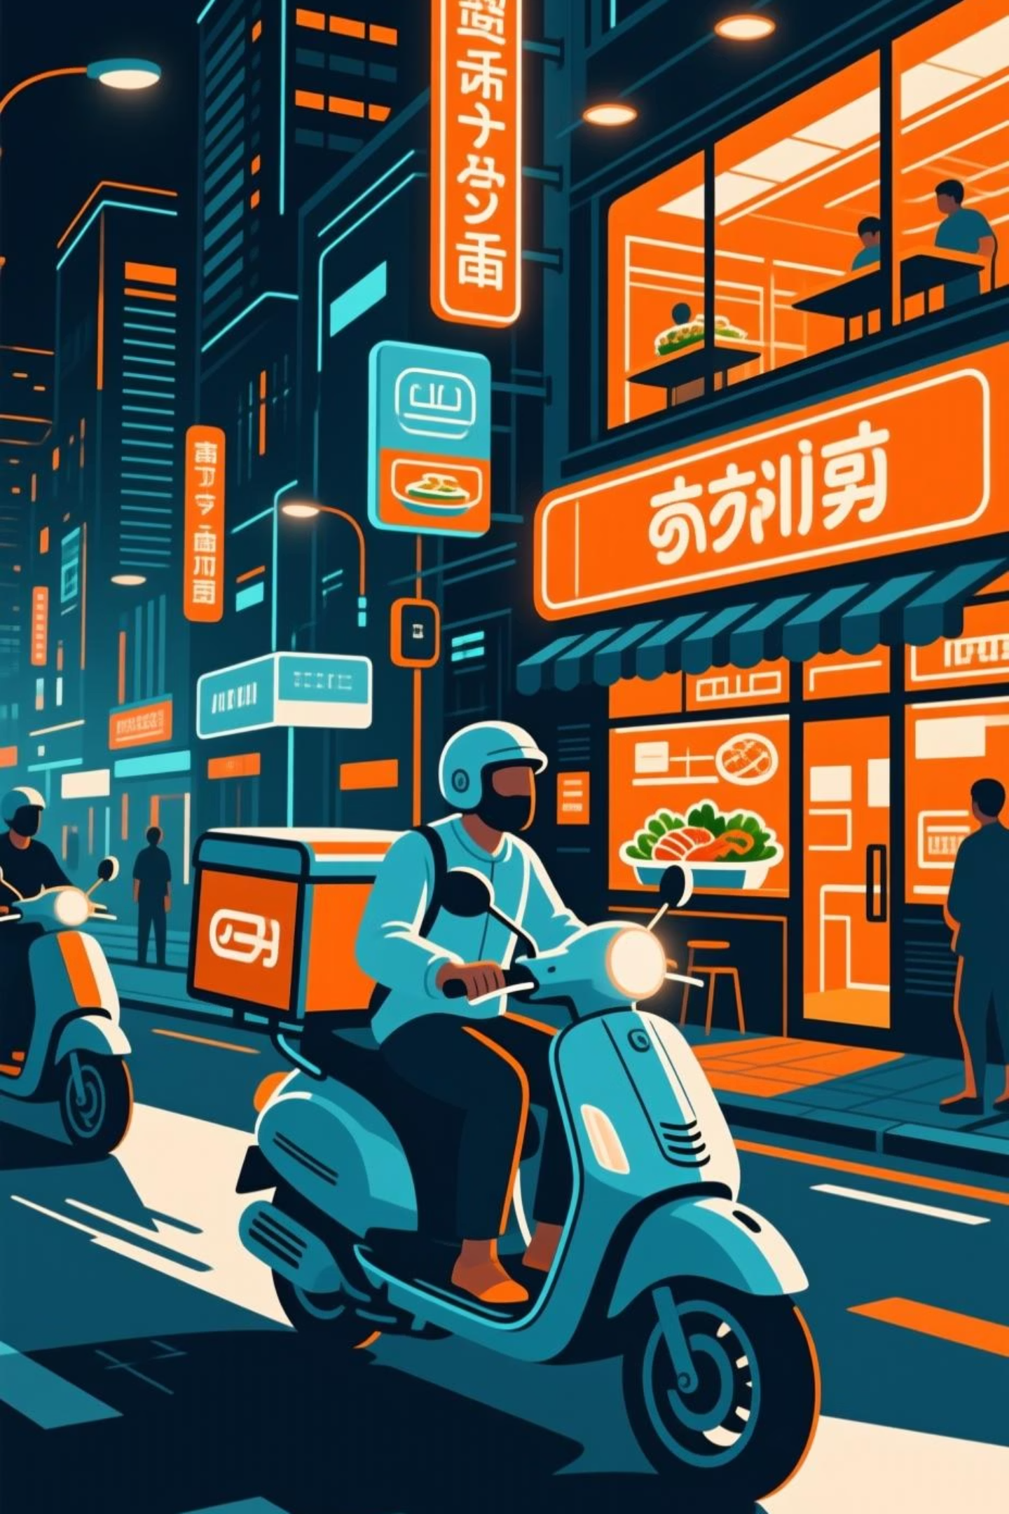
Zomato Delivery System
Revolutionizing Food Delivery in India

Slide 2
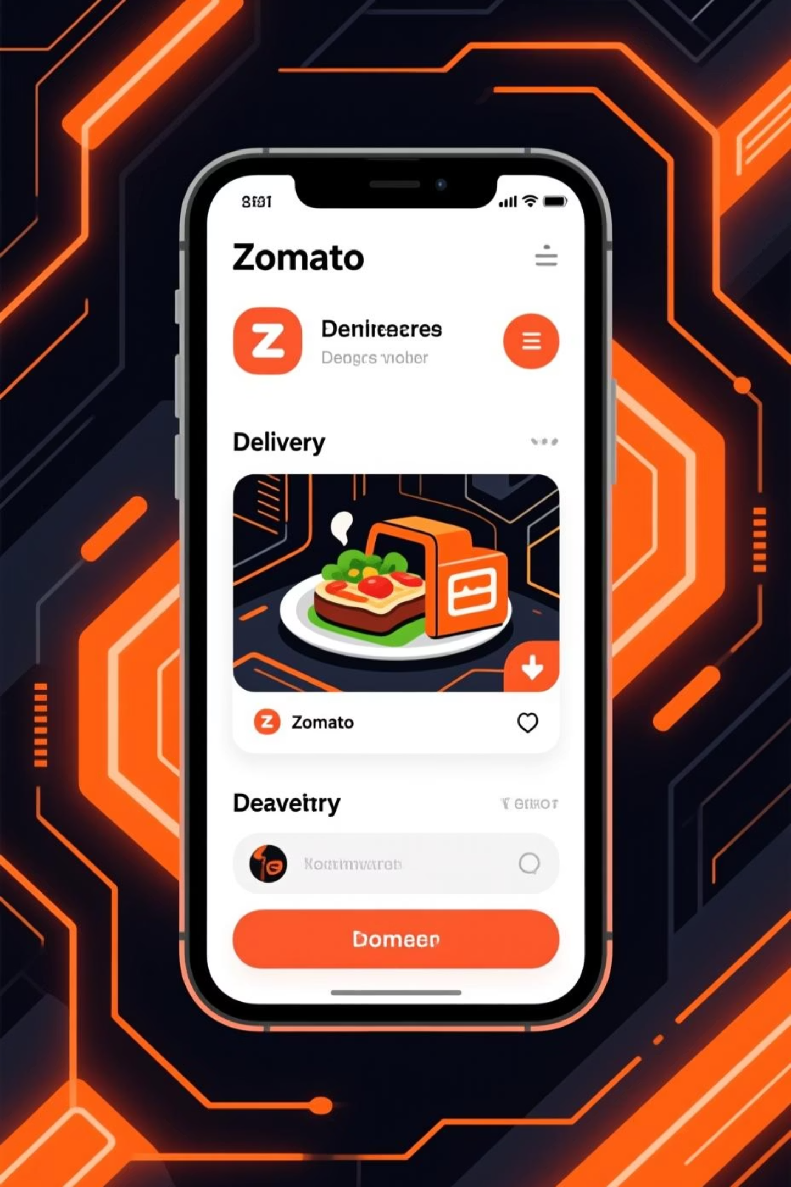
The Zomato Story
1
2008
Founded by Deepinder Goyal & Pankaj Chaddah as a restaurant review platform
2
Evolution
Transformed into India's leading online food delivery app
3
Today
Operating in 1,000+ cities across India

Slide 3
Business Model
B2C Model
Delivery Fees
Ads & Subscriptions
Connects restaurants, delivery partners, and customers seamlessly
Primary revenue from per-order commissions
Additional income from Zomato Gold membership and restaurant advertising

Slide 4
How It Works
01
02
03
Customer Orders
Restaurant Prepares
Partner Assigned
Browse restaurants and place food order through app
Kitchen receives order and begins food preparation
Nearest delivery partner automatically matched to order
04
05
Real-Time Tracking
Doorstep Delivery
GPS tracking provides live delivery updates to customer
Food delivered fresh to customer's location

Slide 5
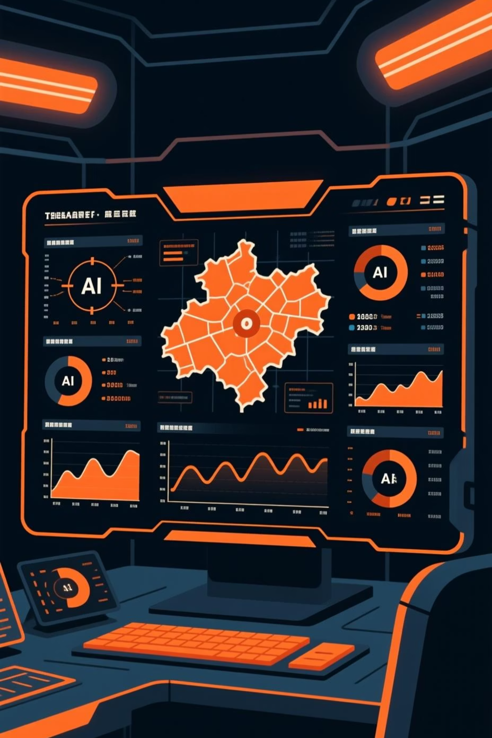
Technology Stack
AI & Machine Learning
Real-Time GPS
Route optimization algorithms reduce delivery times and fuel costs
Live tracking ensures transparency and accurate delivery estimates
Cloud Kitchens
Data Analytics
Expand food availability without physical restaurant locations
Personalized recommendations based on user behavior and preferences

Slide 6






Key Benefits
Employment
Easy Access
Creates jobs for delivery partners across cities
Browse thousands of restaurants instantly
Quick Service
Fast delivery with contactless options
Safety
Contactless delivery protects health and privacy
Quality Feedback
Customer reviews drive continuous improvement

Slide 7
Challenges & Competition
Peak Hour Delays
External Factors
High order volume during lunch and dinner times strains delivery capacity
Weather and traffic conditions impact delivery times and partner safety
Partner Concerns
Intense Competition
Fair compensation and safety for delivery partners remain ongoing issues
Rivals like Swiggy and Blinkit compete aggressively for market share

Slide 8
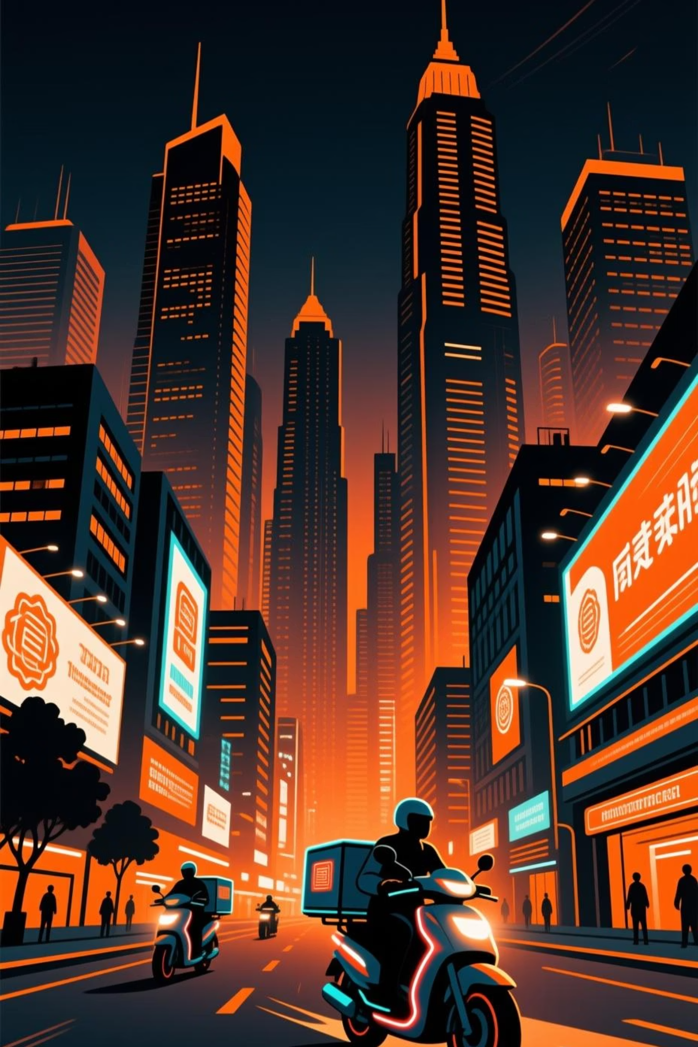
Digital Transformation Impact
Zomato has fundamentally changed India's food industry by digitizing restaurant discovery, ordering, and delivery. The platform balances customer convenience with cutting-edge technology, creating value for all stakeholders.

Slide 9

Future Vision
Expansion
Sustainability
Continued growth across India and emerging markets
Drone Deliveries
Electric vehicles and eco-friendly packaging reduce environmental impact
Autonomous aerial delivery for faster service in select areas

Slide 10
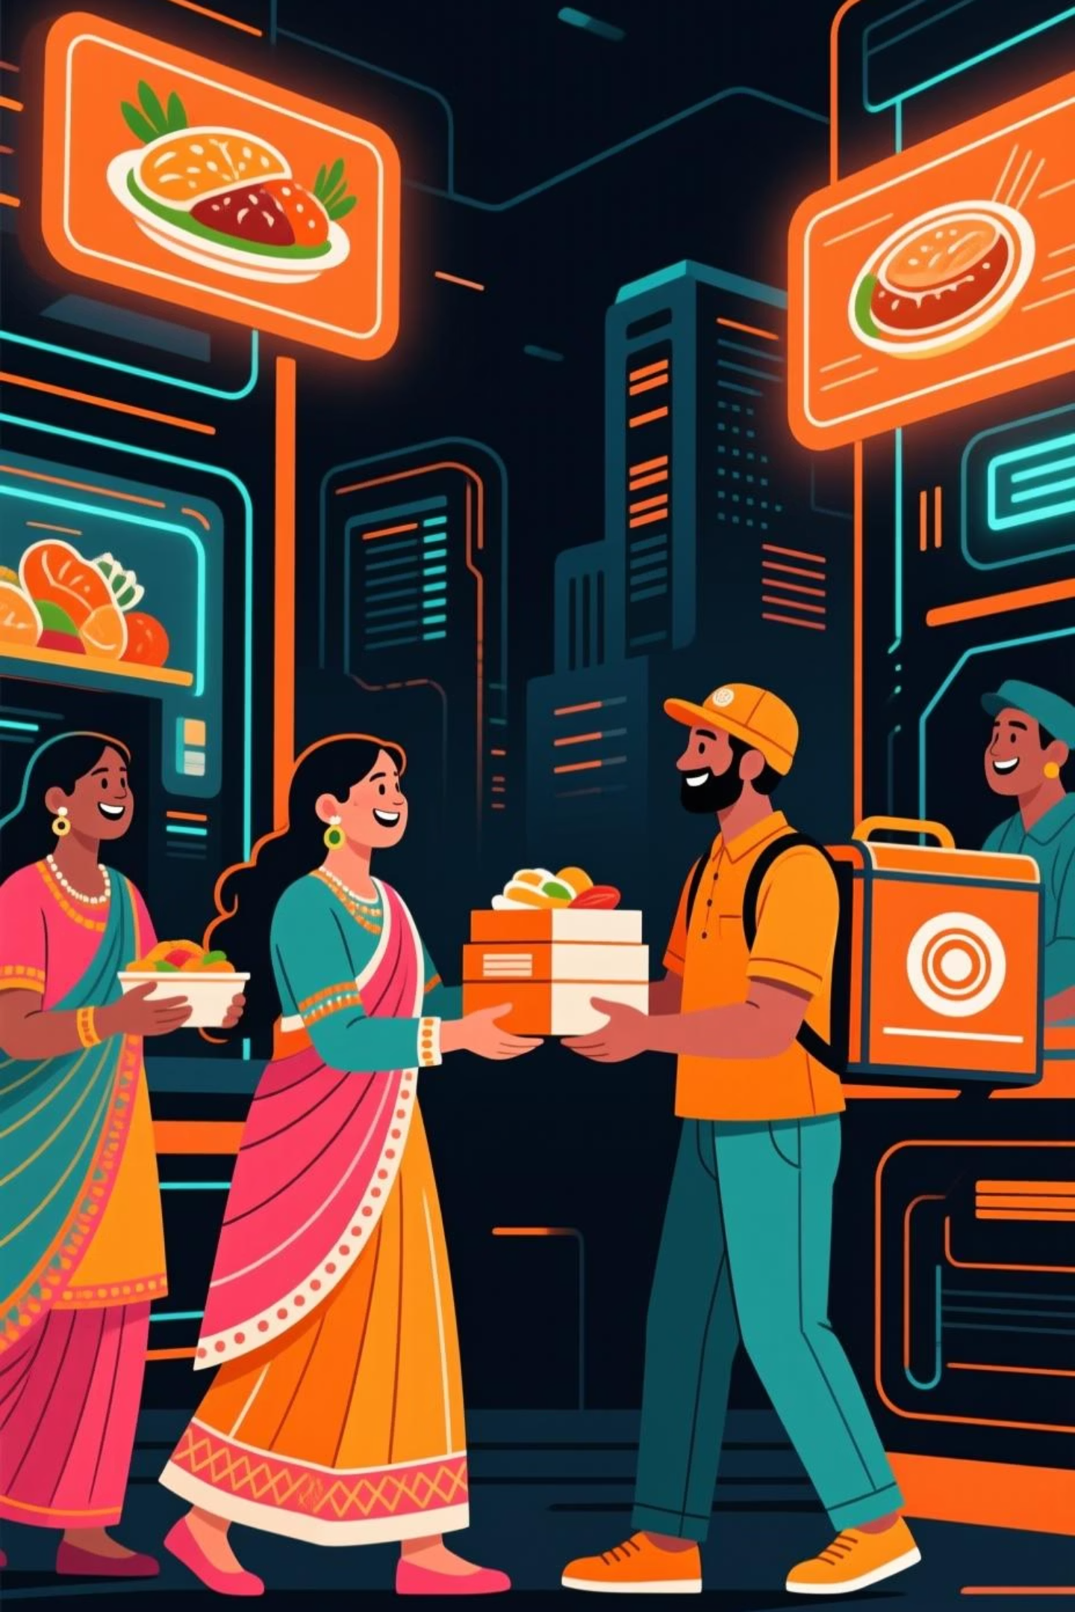
Revolutionizing Food Delivery
Zomato continues to innovate, connecting millions of customers with their favorite meals while creating opportunities for restaurants and delivery partners across India.

